Slide 1
Personal Info
Vivek Kumar (7 years)
M.Tech. in Geophysical Technology

Slide 2
Domain & topic of project
Airline Industry is a system of transportation
Part of Aviation industry
Moving people and goods
Utilizing the airways
One of the only true global businesses Cargo
Topic of Project-- Analyze NYC-Flight data

Slide 3
Introduction (brief info on project)
Analyse the NYC flight data to understand:
The flight behaviour
Speed
Timing
Best carrier
Best airport
Delay analysis etc

Slide 4
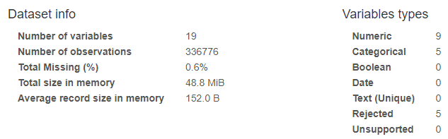
Dataset description
This dataset contains information about all flights that departed from NYC (e.g. EWR, JFK and LGA) in 2013: 336,776 flights in total.
Total 0.6% of missing values
air_time has 9430 / 2.8% missing values Missing Rejected
arr_time has 8713 / 2.6% missing values Missing
dep_delay has 8255 / 2.5% missing values Missing
dep_time has 8255 / 2.5% missing values

Slide 5
Business questions identified
Top 4 late departure carriers and Bottom 4 late departure carriers
Top 4 late arrival carriers and Bottom 4 late arrival carriers
Top 5 airports in terms of timely departure
Top 5 airports in terms of timely arrival
Top 10 best speed carriers
Maximum number of flights headed to some particular destination

Slide 6
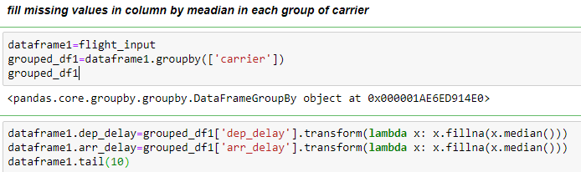

Solution to 1 and 2
Read data using pandas and look for std deviation for each attribute
High deviation indicate to fill the missing value using median or mode
fill missing values in column by median in each group of carrier

Slide 7
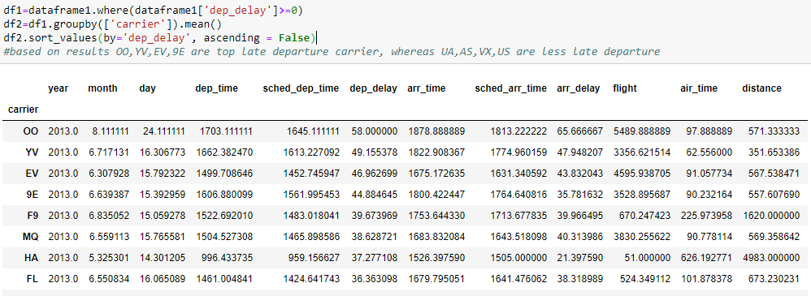
Top and Bottom 4 late departure carriers

Slide 8
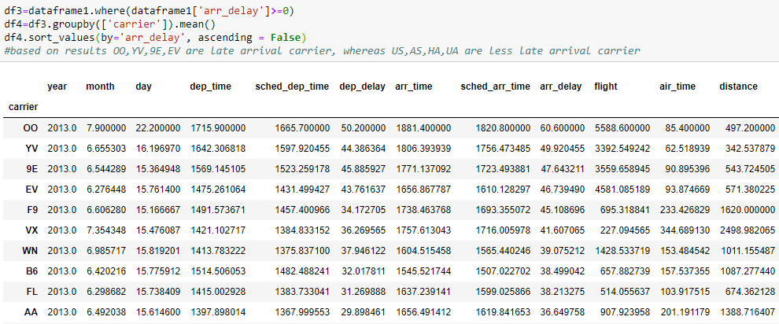
Top and Bottom 4 late arrival carriers

Slide 9
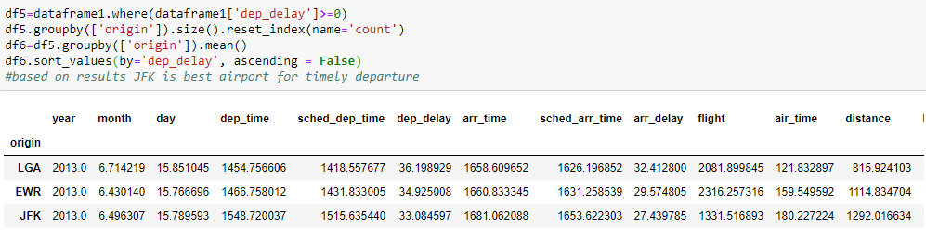
Solution to 3 and 4
Top 5 airports in terms of timely departure

Slide 10
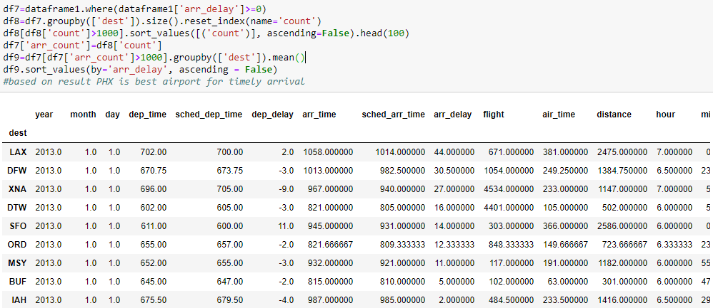
Bottom 5 airports in terms of timely departure

Slide 11
Solution to 5
Fill the missing value using speed of aircraft

Slide 12
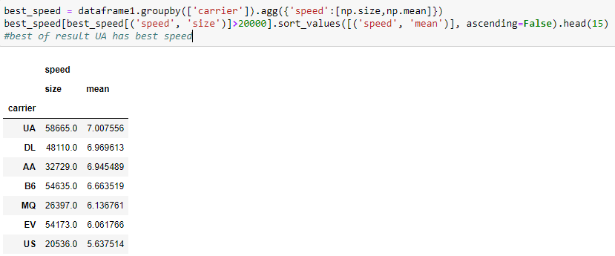
Top 10 best speed carriers

Slide 13
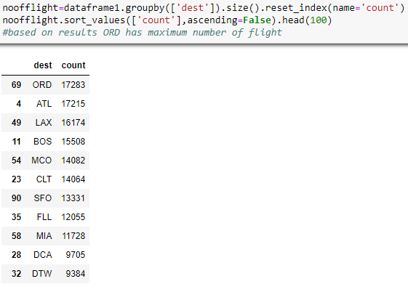
Solution to 6
Maximum number of flights headed to some particular destination

Slide 14
Thank You

